Slide 1

Stage 3 Hidden Cavern Course Designer: 2020 IPSC Alberta Provincial & Marcel Englmaier
Hidden Cavern is a 23 round, 115 point Comstock Long course. There are 10 IPSC targets and 3 steel targets. The best two hits per target will score. Steel must fall to score. The start signal is audible.
The Handgun start position is facing uprange with feet touching marks and wrists above shoulders. Handgun is loaded and holstered. The PCC start position is standing with feet touching marks facing squarely(feet, hips, shoulders, head, muzzle) downrange. PCC is unloaded with stock on belt.
On the audible start signal, engage all targets from within the shooting area. Activator plate activates maxtrap which remains visible at rest.

Slide 2
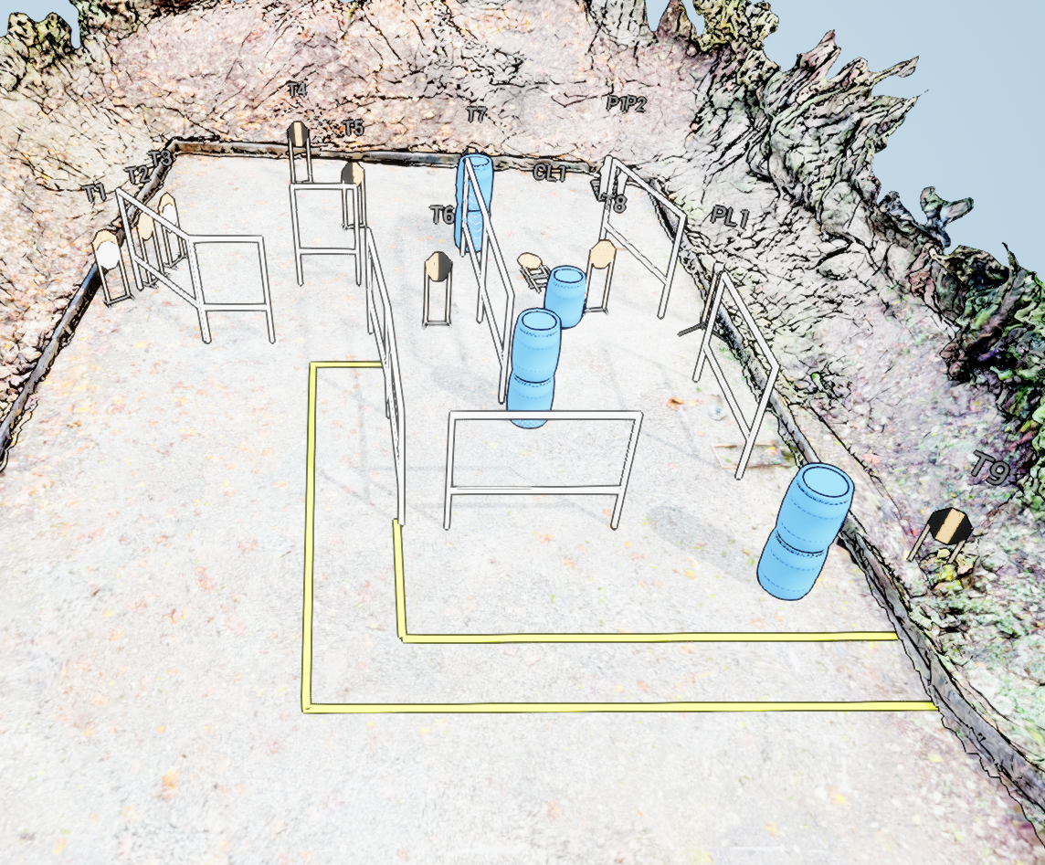
 | Stage 3 Hidden Cavern Course Designer: 2020 IPSC Alberta Provincial & Marcel Englmaier

